Slide 1
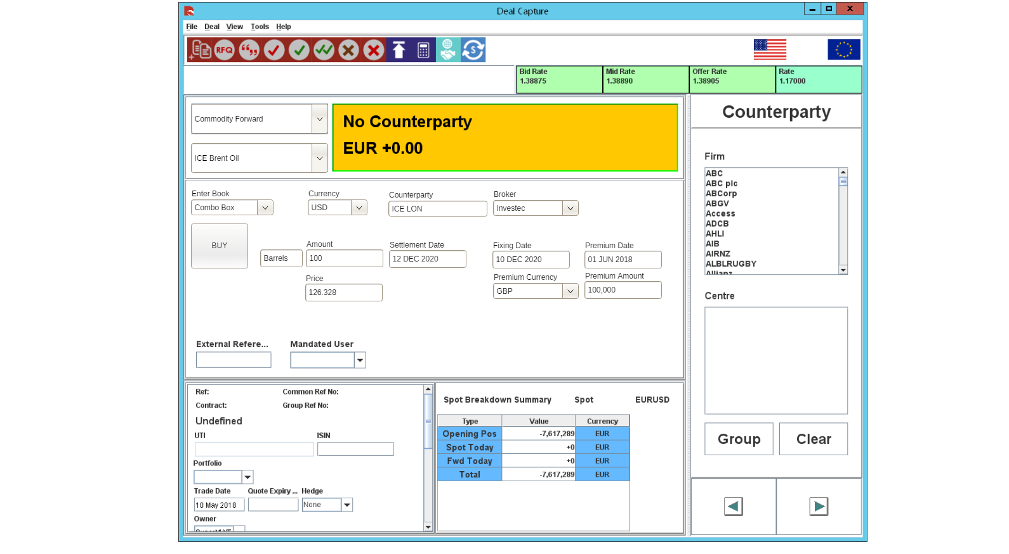

Slide 2
ForwardContractName | TradingUnit
ICE Brent Oil | Barrels
DUMMY1 | Litres
DUMMY2 | Gallons
FIELD | VALUE
Gasoil | Barrels
Fuel Oil | Bushels
Palm Oil | Contracts
Corn | EUR
Ethanol | Gallons
Soybeans | Gigajoules
Wheat | MT
Platinum | None
Gold | Pecent
Silver | Pounds
Brent Oil | Therms
Diesel | Tonnes
Ethylene | Troy
High Sulphur Fuel Oil | mmBTU
Values from temp Properties File
Values defaulted when ICE Brent Oil selected in dropdown above

Slide 3
Field name | Detail
Deal Type | Commodity Forward
Commodity Forward | Select from Commodity_Forward Table
Direction | Buy or Sell (from the banks perspective)
Volume | Numeric – allow for decimals up to 4 places e.g. 5 in 5 Tonnes
Unit | Select from Commodity_Forward Table (Display) e.g. Tonnes
Currency | Should default from Commodity_Forward Table – could be edited
Price | User enters contract price per unit. Could be defaulted from Commodity Forward Spot Prices
Fixing Date | This will default to spot days before the settlement date – can be overridden by user
Settlement Date | Users enters or select settlement date for forward deal
Premium/Fee Currency | Defaults from Commodity_Forward Table – could be edited [Optional]
Premium/Fee amount Currency | User enters a value
Premium/Fee Start Date | Defaults to Spot days for the currency – can be edited
Commodity Forward - Entry
Workflow
Select Deal Type
Select Commodity Forward
Select Direction
Enter volume
Select Currency
Enter Price
Enter Settlement Date
Enter Premium/Fee amount
Enter Premium/Fee amount Currency
Select Premium/Fee Start Date
Select Portfolio, Book, Broker, traded/hedged etc. as usual
Validate > Complete or Confirm
Key field information

